Slide 1
Isostress and Isostrain Analysis of PLA
Group 1

Slide 2
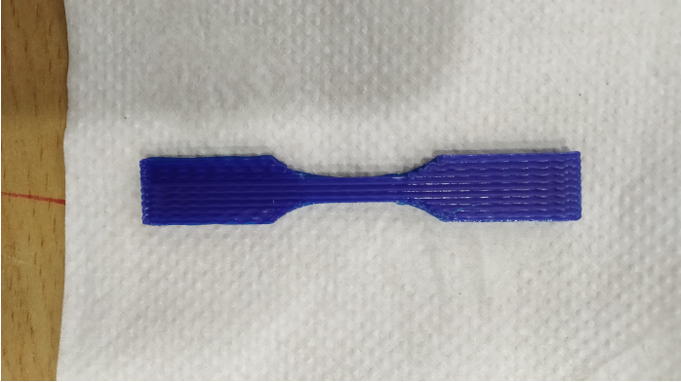
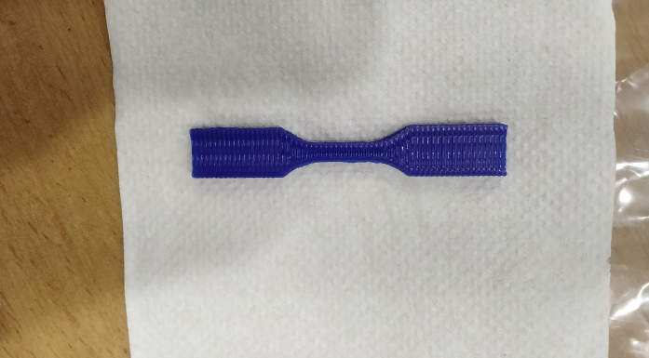
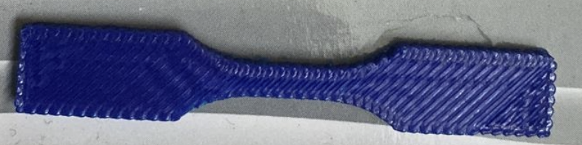
Objective
To demonstrate differences in mechanical properties of isostress, isostrain and an intermediate orientation (45º) in additively manufactured PLA samples
To demonstrate the dependence of yield strength and elastic modulus on temperature
To analyse fracture of samples in the three different orientations

Slide 3
Timeline
Data Analysis, FEM and Presentation
Experiment Design
3D Printing
06.10.22
16.10.22
17.10.22
19.10.22
4.11.22
CAD Model
Experimentation

Slide 4
Contributions
Darshan: 3D printing of Samples, Compiled knowledge - 3D printing, Microstructure Imaging
Soham: Design of Experiments, Experimentation, Group Organisation
Advait: Experimentation, Report
Shardul: Experimentation, CAD Model for 3D Printing
Hiranmai: Presentation, Microstructure Imaging, Theoretical Correlations, ImageJ Analysis
Devashish: Basic knowledge of 3D printing, Theoretical Correlation, Design of Experiments
Satyam: Theoretical Correlation, 3D printing of Samples, Presentation
Daniel: ANSYS simulations
Pratik: Video editing and ImageJ Analysis
Anshuman: Data Processing, Analysis and Plotting, 3D printing

Slide 5
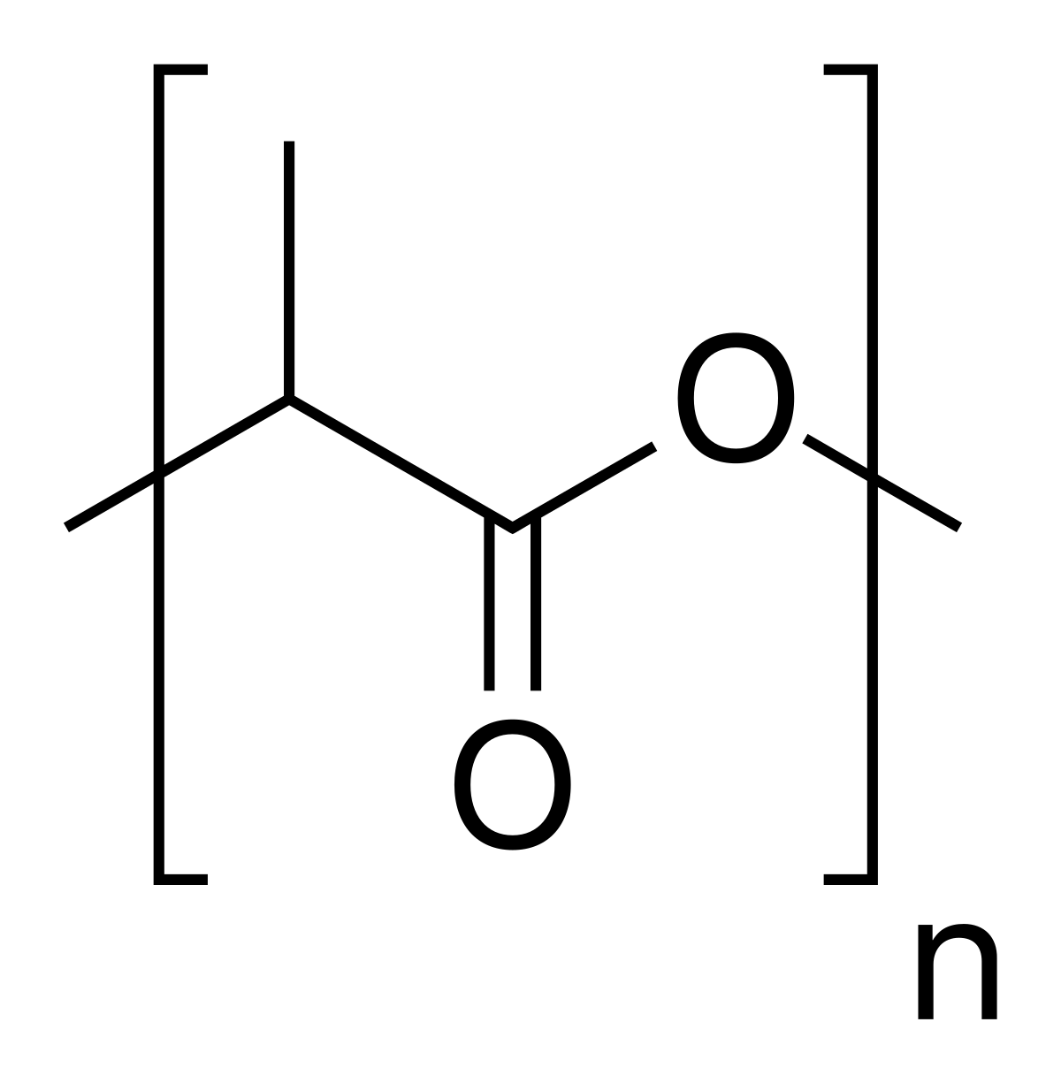
Introduction
Isostress and Isostrain Behaviour
3D Printing → Additive manufacturing
Additive manufacturing → Path of printing
Path of printing → Directional layers of PLA
Loading direction with respect to layers of PLA → isostress/isostrain condition
Temperature Dependence
PLA → Polyester
Polyester → Entanglement of bonds?
Temperature dependence?
PLA
(Polylactic Acid)

Slide 6
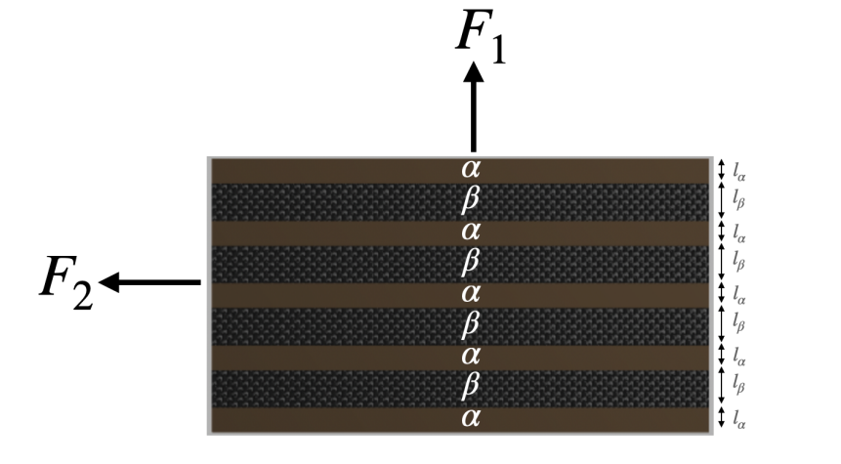
Isostress and Isostrain Models
Isostress:
F₁ loading:
Areas equal → Equal stresses
Isostrain:
F₂ loading:
Geometrical constraints → Equal strains

Slide 7
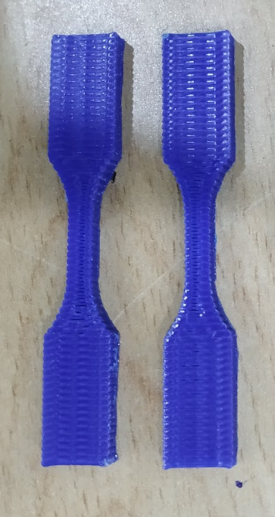
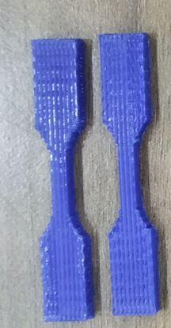
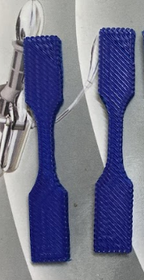
Samples
Isostress
Isostrain
45º

Slide 8
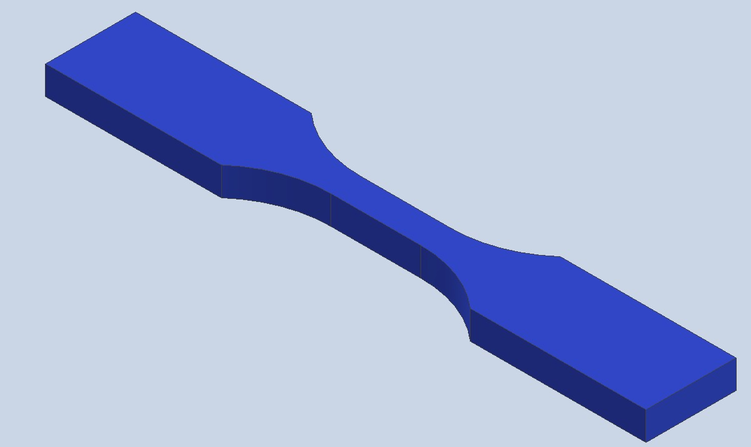
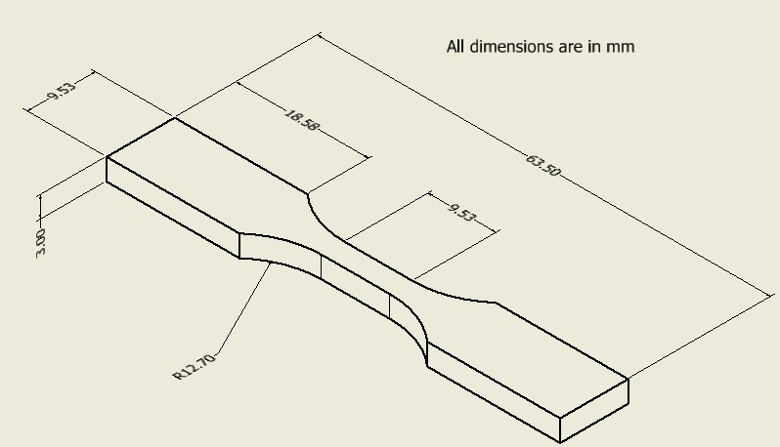
CAD Model: Sample for Testing
3
4
63
Dimensions: 63 mm x 3 mm x 4 mm
Taken as is from Literature(Reference (1))

Slide 9
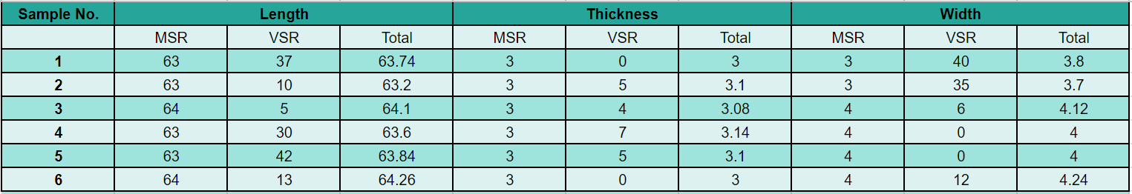
Sample Dimensions
Average: Length = 63.79 mm; Thickness = 3.07 mm; Width = 3.98 mm

Slide 10
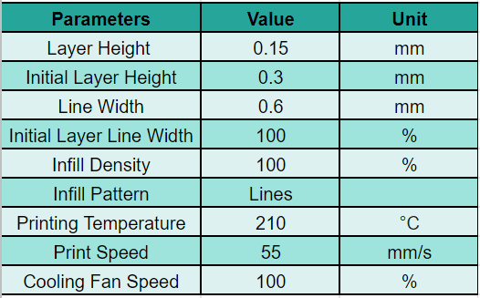
Printing Parameters: 3D Printing
Printing Temperature:
Kept just above the melting point of PLA(190 °C) to facilitate flow for printing and just below 220 °C to avoid decomposition of PLA.
Printing Speed:
Kept constant for all samples since it affects the strength

Slide 11
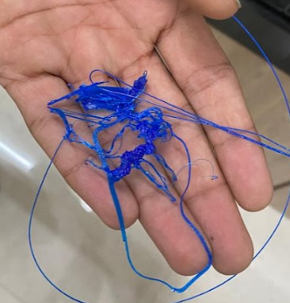
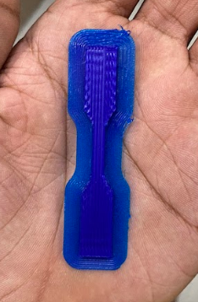
3D Printing: Problems Faced
Issues faced while 3D Printing:
Sticks to nozzle instead of support
Sample bends upwards when nozzle stops printing
Solutions:
Add brim for better adhesion
Monitor sample continuously

Slide 12
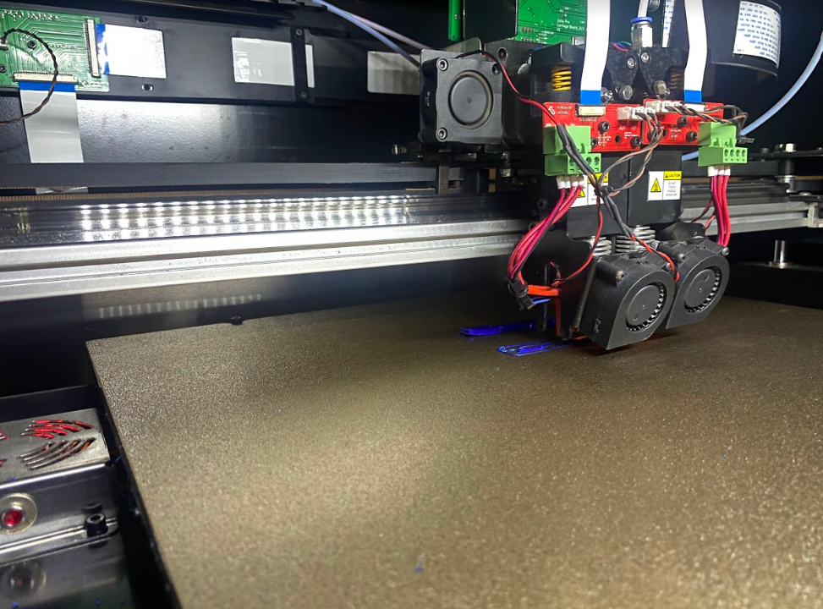
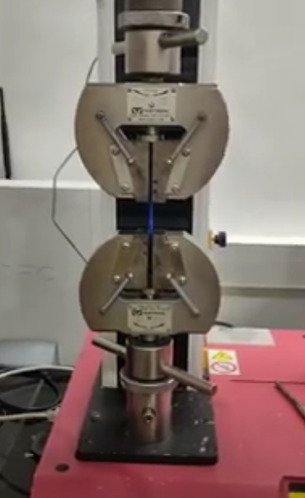
Methodology: Experiment Design(UTM)
3D printed 29 Dogbone shaped PLA samples: 1 for temperature calibration, 26 for testing in the UTM and 1 damaged due to a weak grip in the UTM
The Universal Testing Machine(UTM) was used to measure the stress-strain behaviour of the samples to quantify yield strength, elastic modulus and ductility
Optical Microscope was used for a basic microstructure analysis of the samples
Notes:
We 3D printed a total of 27 samples. Out of which 12 were IsoStress, 12 were IsoStrain and 5 were printed at 45 degree orientation. The plan was to perform tensile test of the samples at 3 temperatures. We performed 3 tests at the same temperature to eliminate any errors or inconsistencies. The glass transition temperature of PLA is 50 Degrees centigrade hence we chose to test the samples at reduced temperatures instead of elevated temperatures. After 3D printing we cleaned the samples and took the images under a microscope to identify features and the spacing between the fibres in both the orientations. We used the INSTRON 5kN Universal testing machine with manual griping to test the samples.

Slide 13
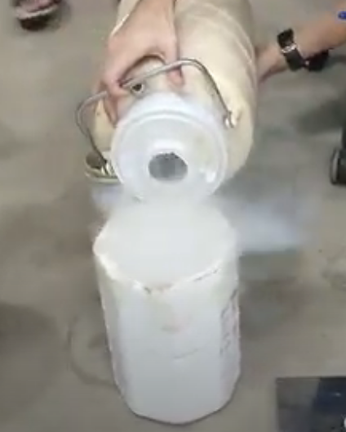
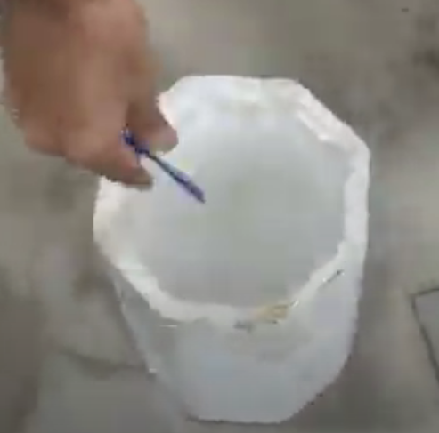
Methodology: Experiment Design
3 Temperatures below the glass transition temperature of PLA(50-80 °C) were chosen:
Isostrain: 26.5º C, -48º C, -21º C
Isostress: 26.5º C, -72º C, -21º C
45º: 26.5º C
3 samples at each temperature were taken to minimize errors in readings
For low temperature measurements, liquid Nitrogen was used to cool the samples

Slide 14
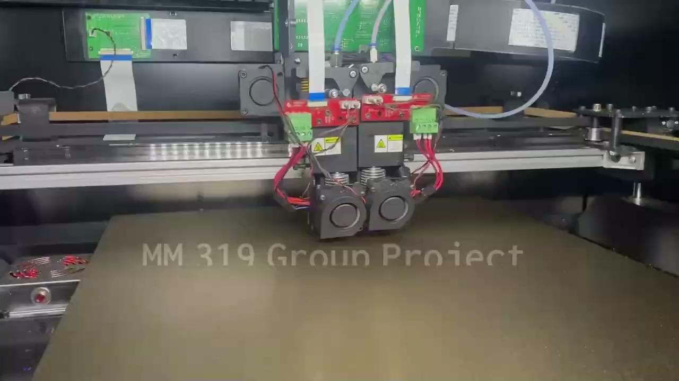
Video

Slide 15
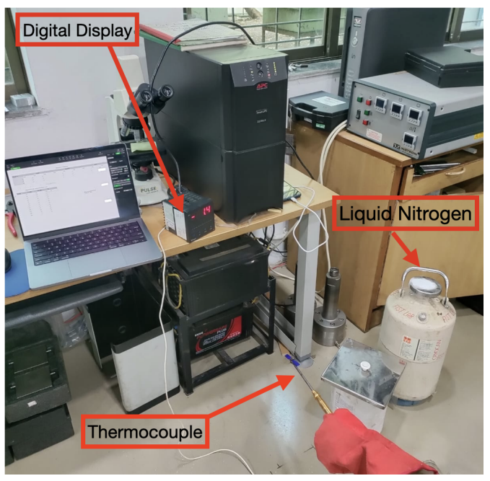
Temperature Calibration: Setup
Temperature - Time correlation to account for cooling down during testing
Equilibrate with liq N₂ at about -190º C
Record temperatures at every 15 s for a 120 s interval. Repeat thrice.
Plot values and use correlation to calculate approximate temperature according to time taken to load

Slide 16
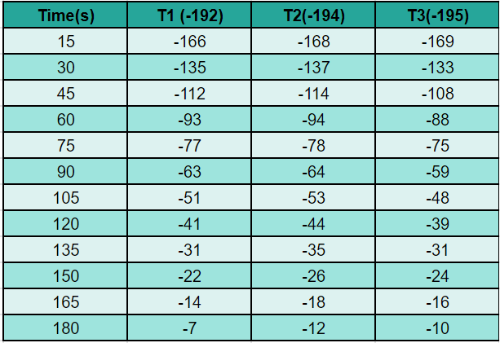
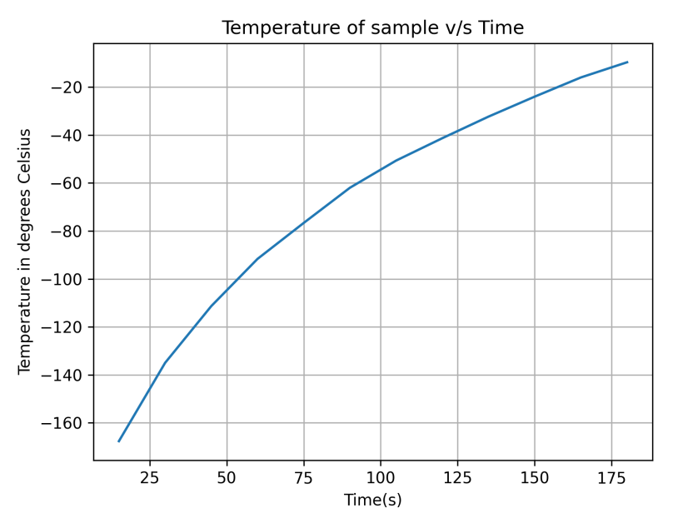
Temperature Calibration: Data

Slide 17
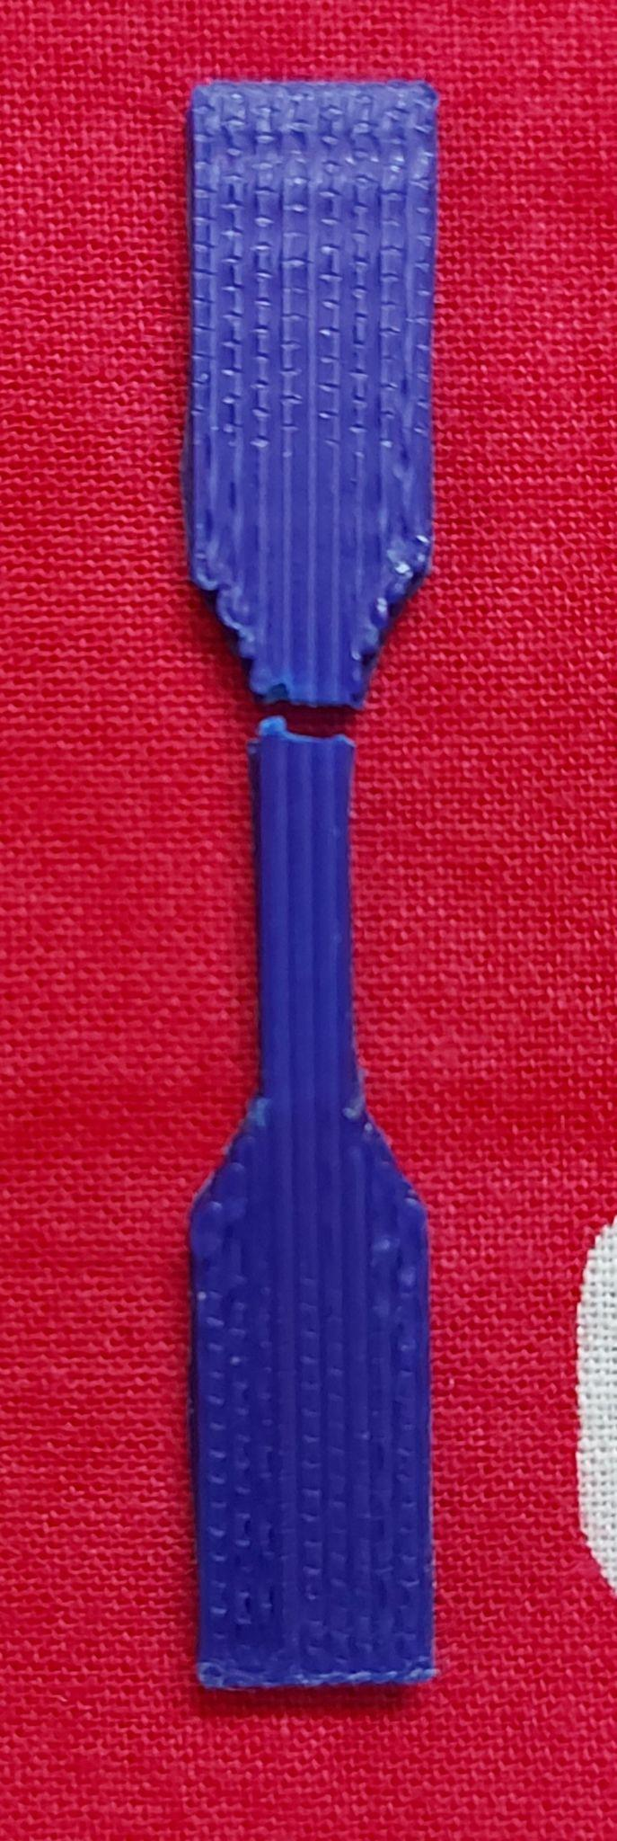
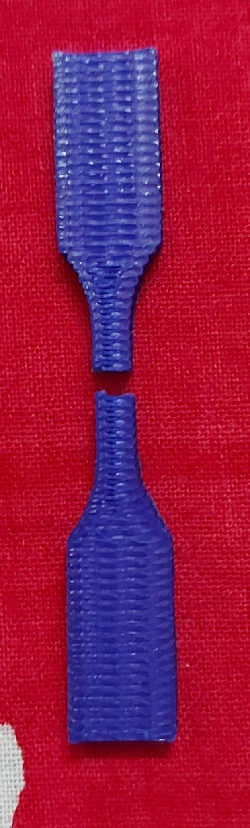
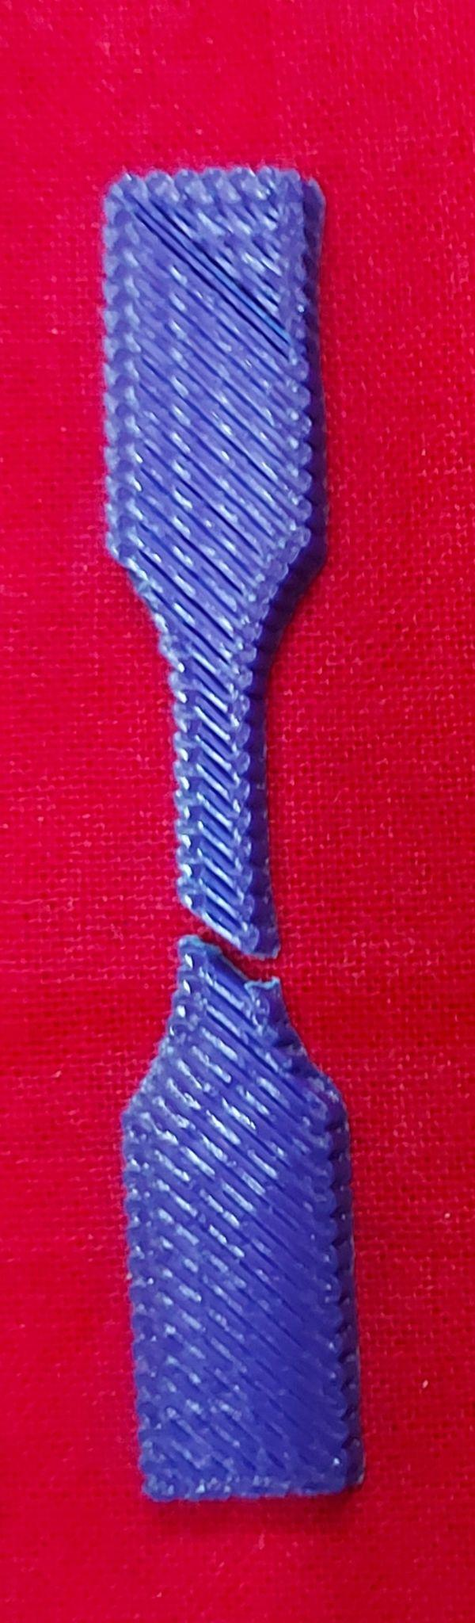
Analysis: Fractured Samples
Observations:
Fracture in Isostress and 45° along fibers and Isostress approximately near center
Isostrain fractures near grip through fibers
Speculation:
All the samples have sharp corners, these may be areas of stress concentration
In case of isostress and the intermediate case the fracture is easier along the fibre whereas in the isostrain it takes place close to the point of stress concentration
Isostrain
Isostress
45º

Slide 18
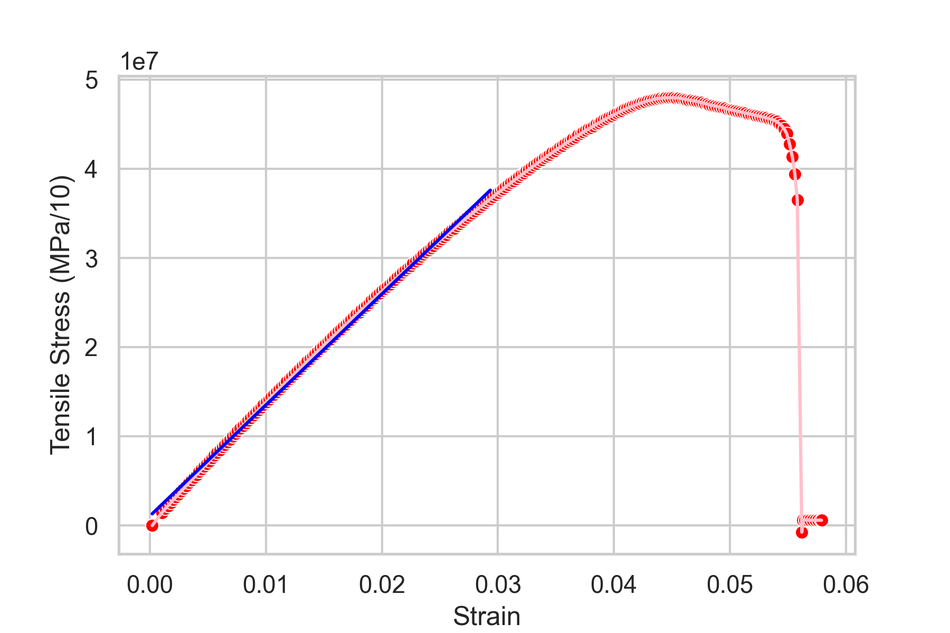
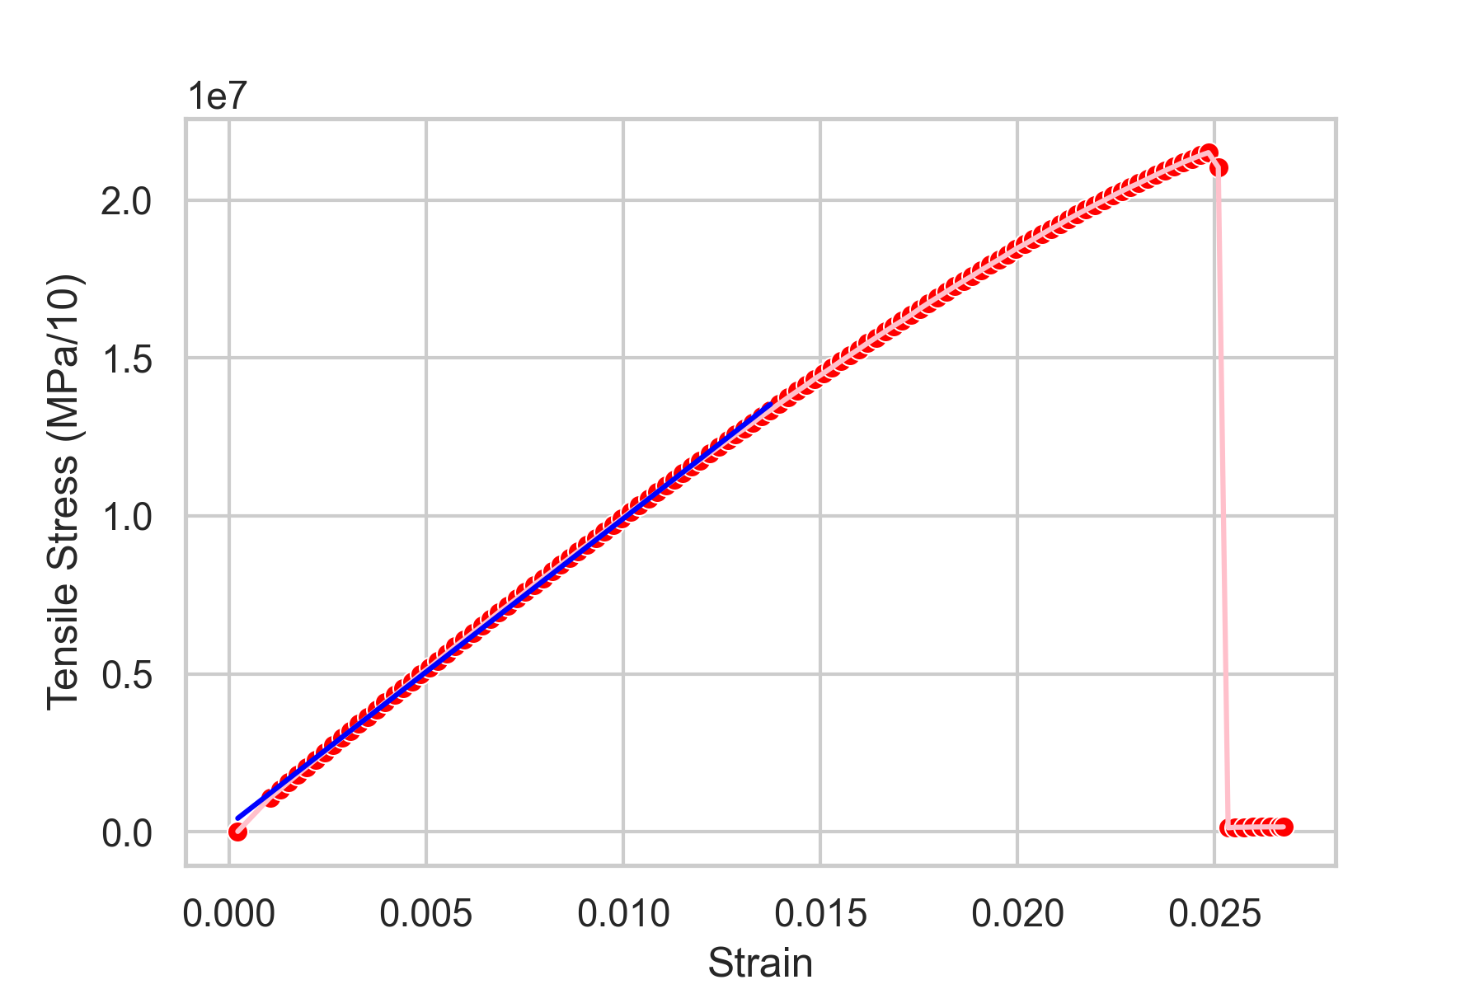
Fracture: Isostress v/s Isostrain
Isostrain → Fracture across fibers → Failure over a range of strain values beyond the UTS
Isostress → Fracture along layer interface → abrupt failure at single strain value

Slide 19
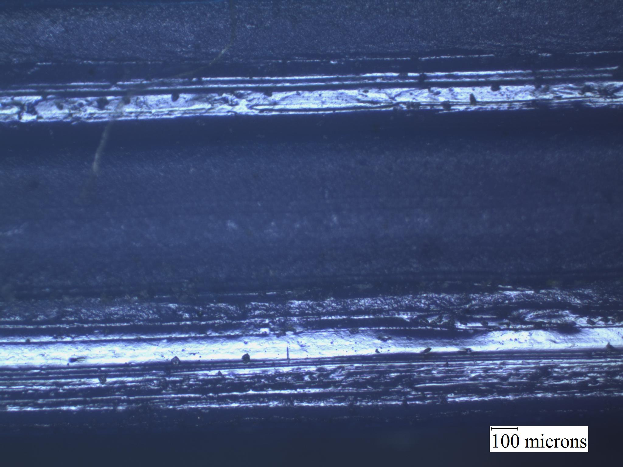
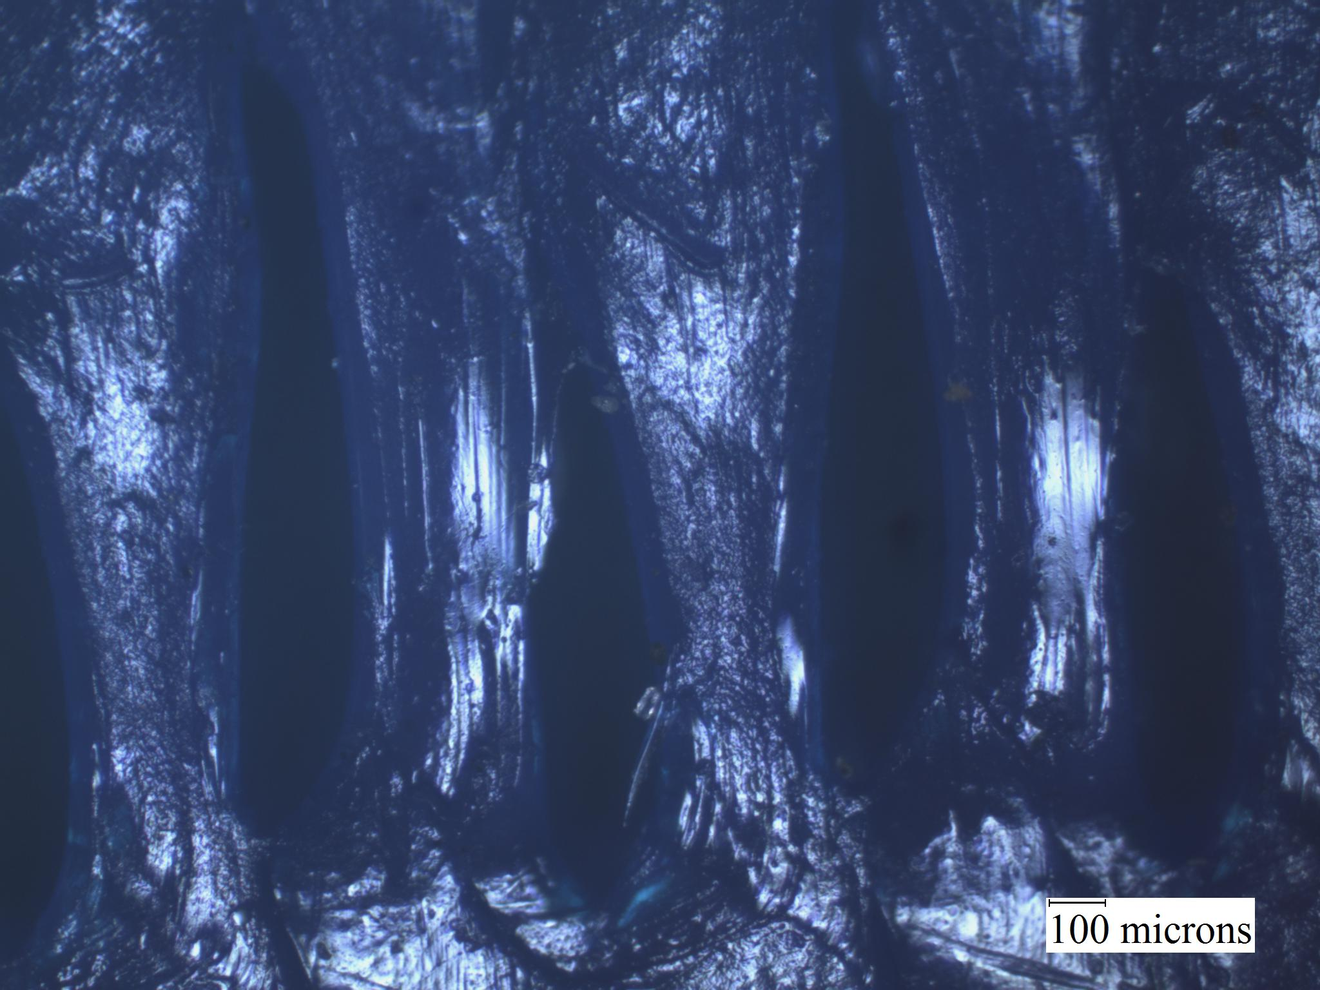
Speculation using Microstructures
Elastic Behaviour: As expected from theory
Ductility: Stretching along the fiber length in isostrain
Isostrain: Fracture due to extension along fiber lengths - ductile fracture - fiber by fiber
Isostress: Fracture at interface between layers (delamination) - fails earlier
Isostrain
Isostress

Slide 20
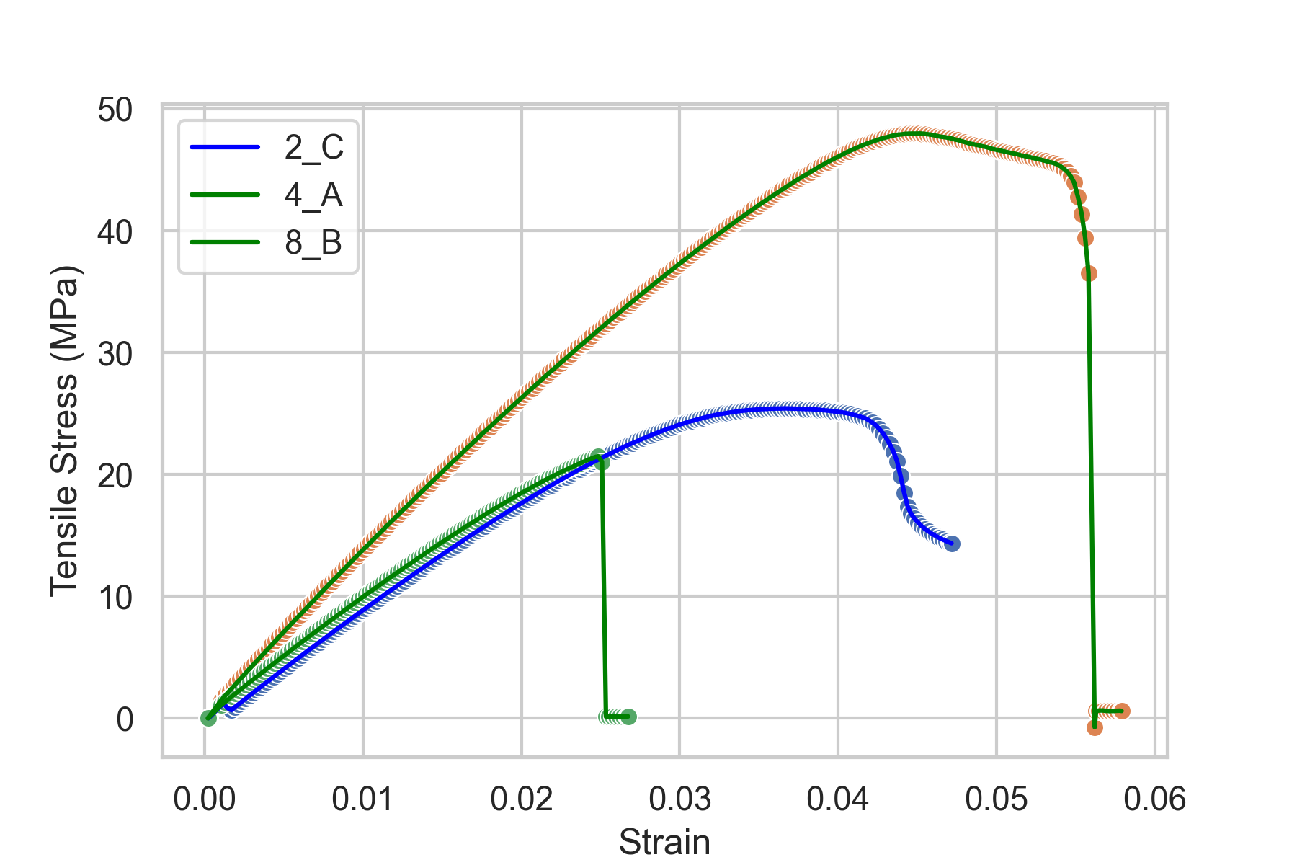
Observations: Elastic Behaviour
Yield Strength and UTS:
Isostrain > 45° > Isostress
Elastic Modulus:
Isostrain > 45° ≃ Isostress
Ductility (Max strain taken):
Isostrain > 45° > Isostress
Yellow - Iso-Strain
Blue - 45 deg
Green - Iso-stress

Slide 21
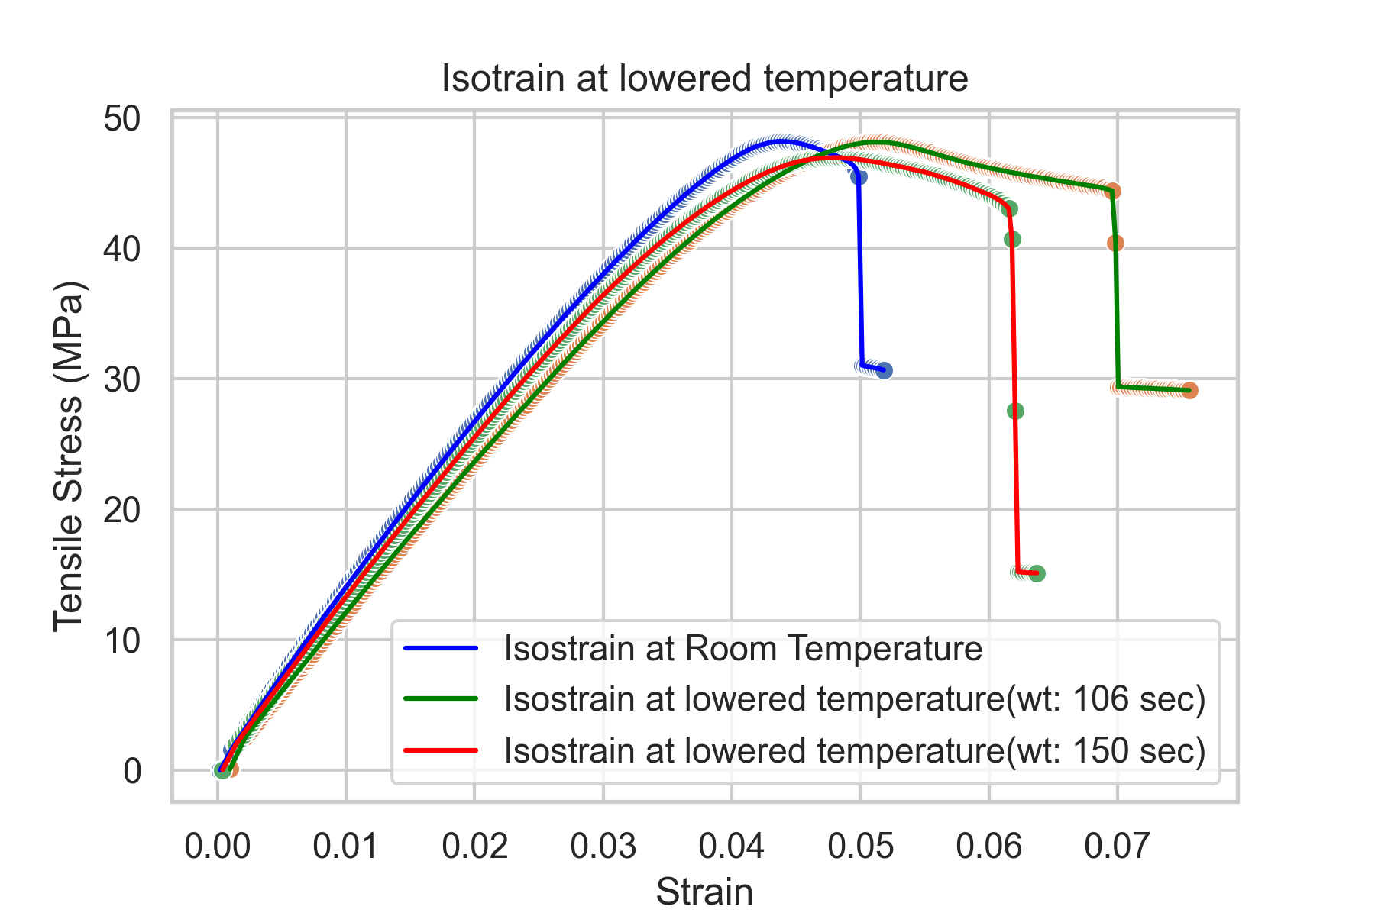
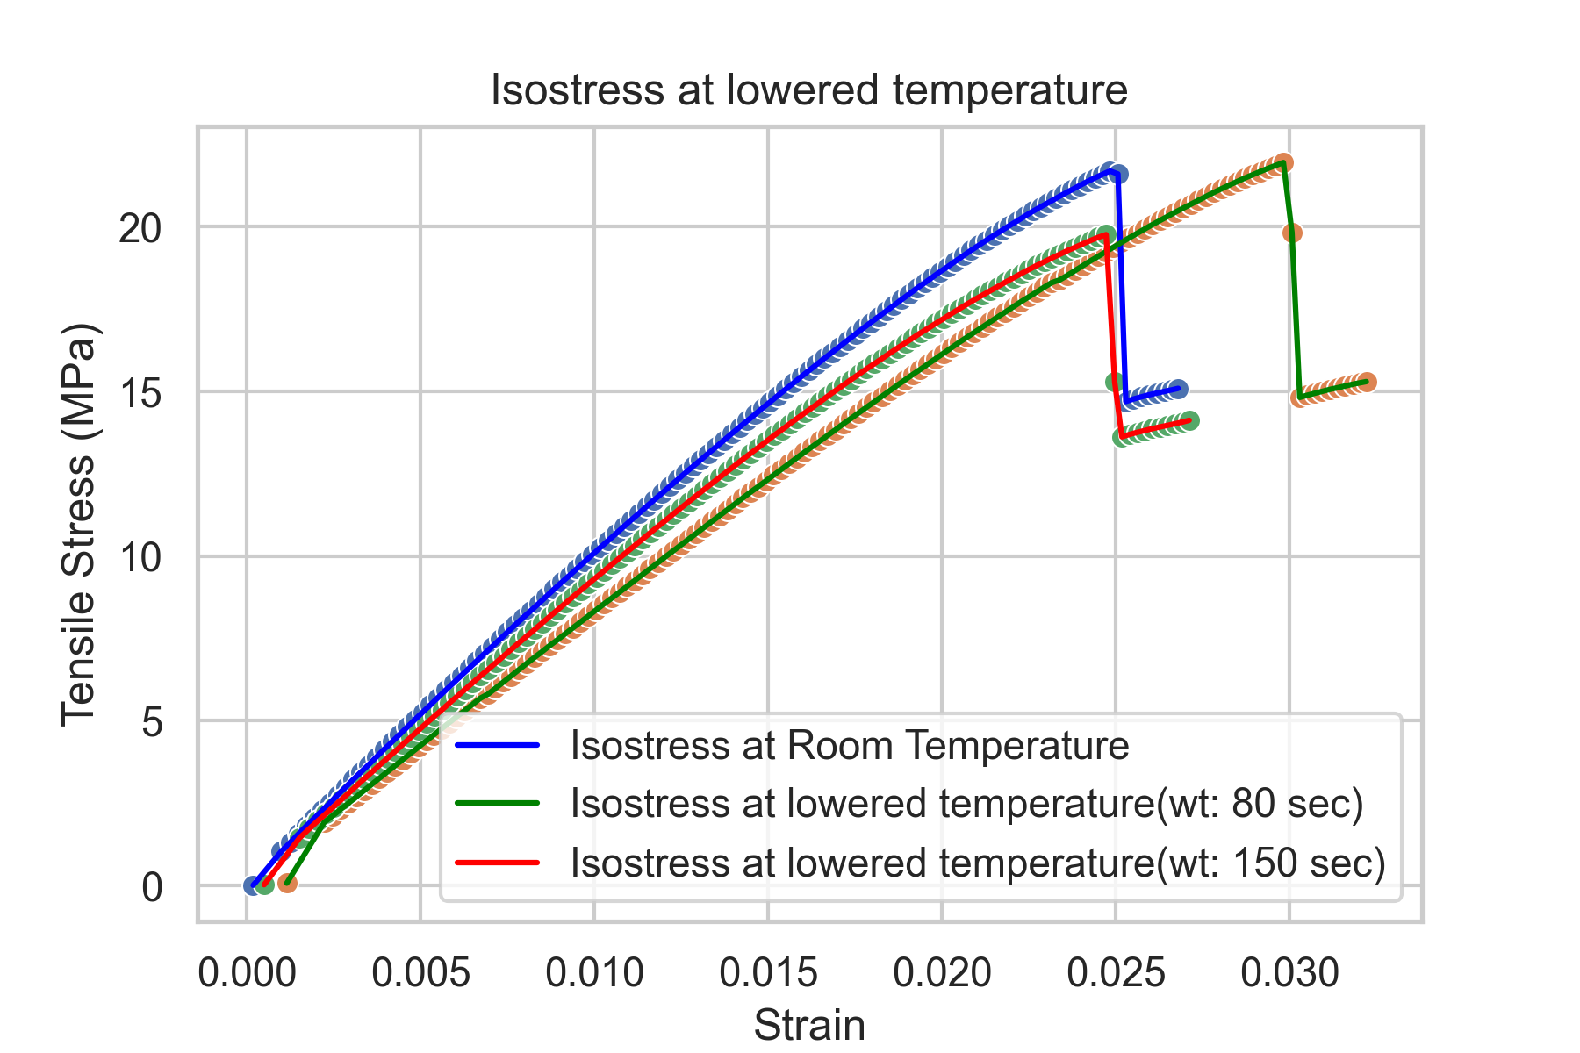
Plots: Temperature Dependence
Observations: Elastic modulus is higher for higher temperatures for both isostress and isostrain
Ductility increases with decreasing temperature
Speculations: At high temperatures: Only pulling of bonds contributes to ductility
At low temperatures: Disentanglement and pulling of bonds - higher ductility

Slide 22
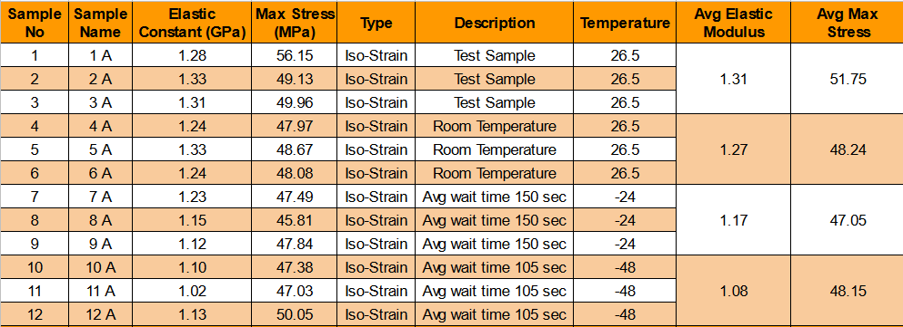
Maximum Stress Calculations
Maximum stress observed (Isostrain): ≃ 47 - 50 MPa;

Slide 23
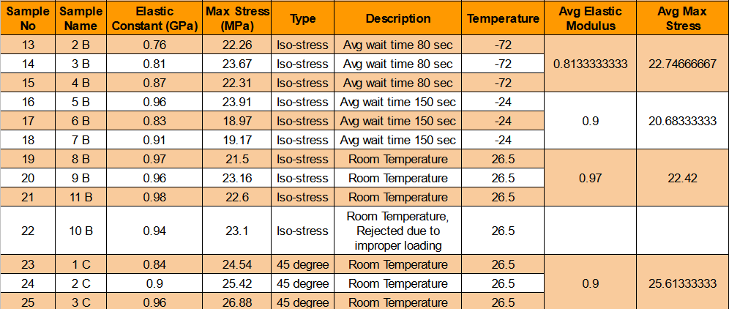
Maximum Stress Calculations
Maximum stress observed (Isostress): ≃ 19 - 23 MPa; 45º - ≃ 24-26 MPa

Slide 24
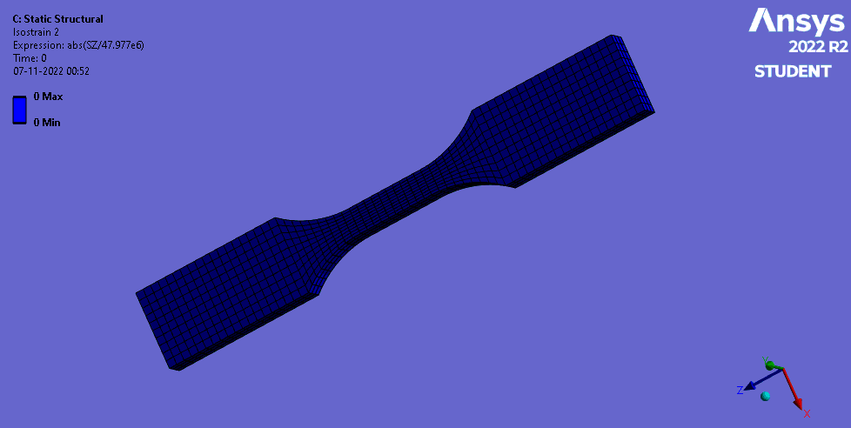
Static Structural Simulations
Boundary Conditions:
Fixed Support (right)
Displacement (left)
Assuming Isotropic Elasticity: E=1.01GPa
Failure occurs at same location as predicted by simulation
Failure point of Isostrain sample (determined using Hill’s criterion)

Slide 25
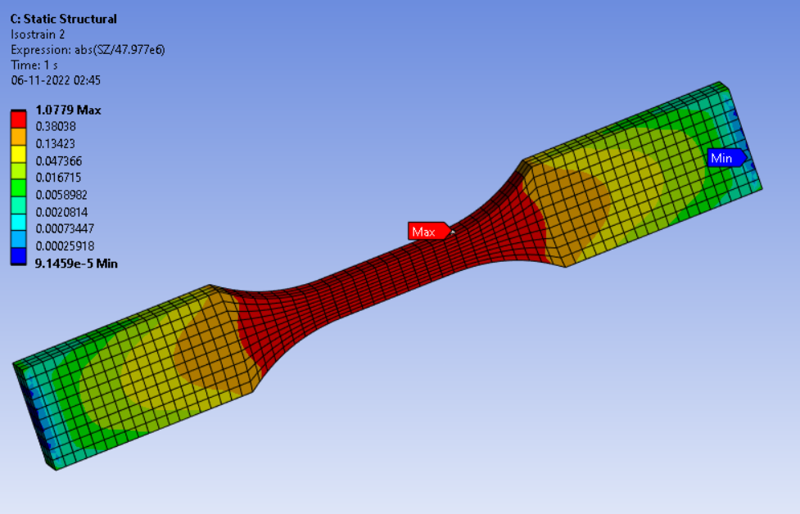
Static Structural Simulations
Boundary Conditions:
Fixed Support (right)
Displacement (left)
Isotropic Elasticity:E=1.01GPa
Failure occurs at same location as predicted by simulation
Failure point of Isostrain sample (determined using Hill’s criterion)

Slide 26
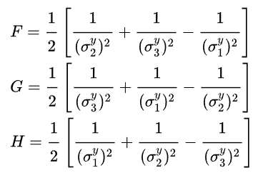
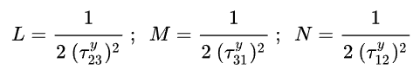
Static Structural Simulations
Experimental maximum stresses can be used to predict failure based on Hill Yield Criterion (for samples with same print parameters printed along direction corresponding to index 1)
σ₁^{y} | Isostress sample | 22.42 MPa
σ₂^{y} | Isostrain sample | 48.24 MPa
σ₃^{y} | Isostrain sample | 48.24 MPa
𝜏₁₂^{y} | Schmidt Factor: σ₄₅^{y} / 2 | 12.81 MPa
𝜏₂₃^{y} | Von-Mises Criterion: σ_{isostrain}^{y} / √3 | 27.85 MPa
𝜏₁₃^{y} | Schmidt Factor: σ₄₅^{y} / 2 | 12.81 MPa

Slide 27
References
Standard test method for tensile properties of plastic
Rafts, Skirts and Brims
3D Printing PLA Filament
Tensile Testing for 3D Printed Materials
Hill Yield Criterion
Data Analysis Script
We would like to thank Pragyesh who helped us a lot in 3D printing, understanding the experimentation part and analyzing the results.
We like to express our gratitude towards Mr Naik and Mrs Neelam who helped us a lot with our experiments and with the microimaging.
Link to Code: Code

